Slide 1
DCM
Presented By Jack Scully

Slide 2
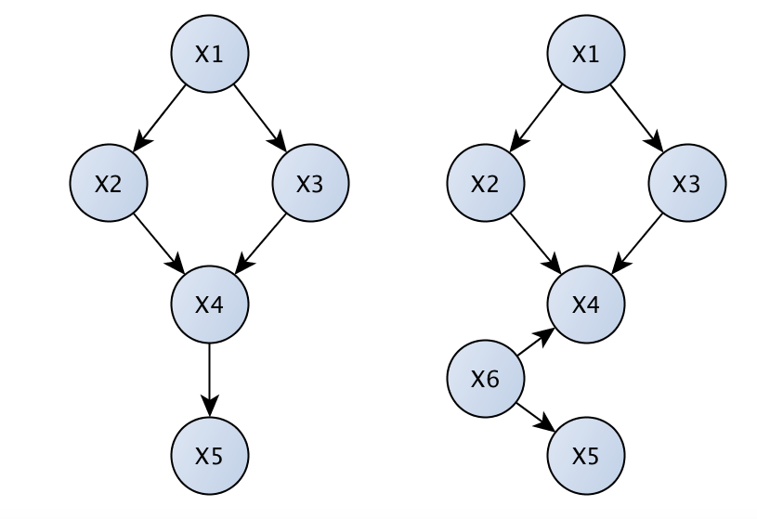
Goal: identify effective connectivity
Causal (effective)
Physiological (structural)
Statistical (functional)
How? EM!
Variational bayes to estimate model evidence (free energy)
Dynamical forward model to estimate BOLD response
After EM, sparsity in parameters yields Connectivity

Slide 3

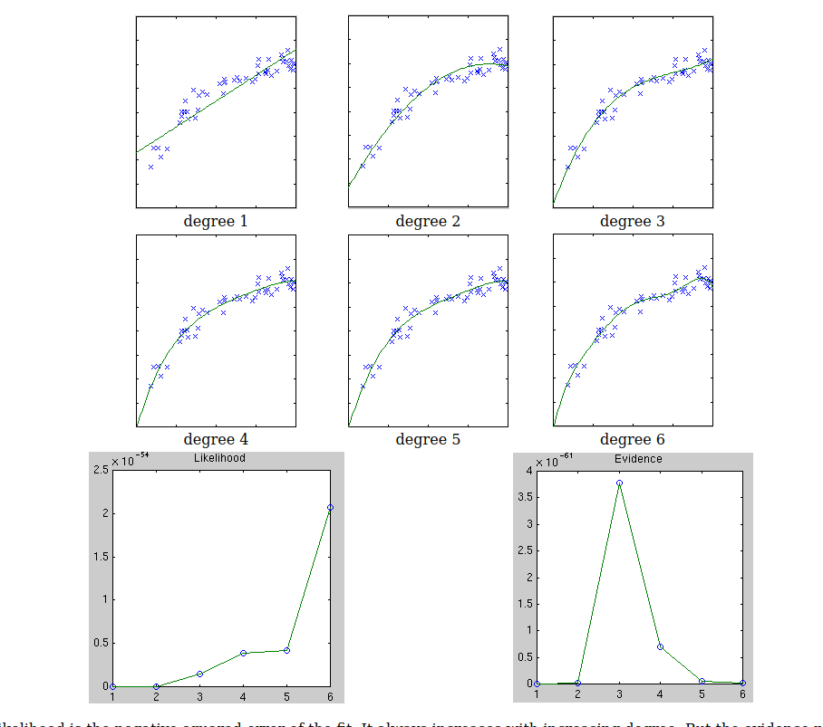
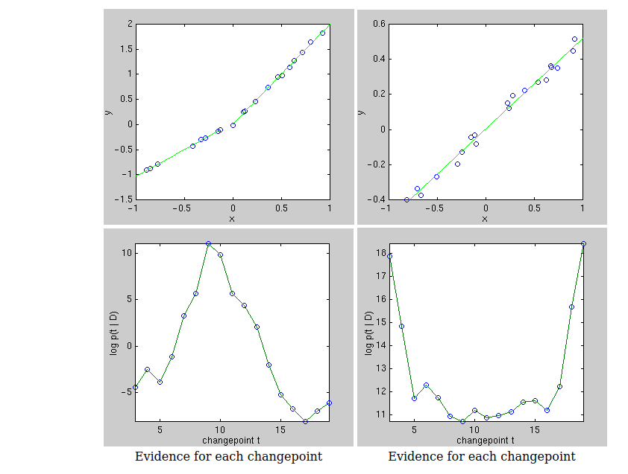
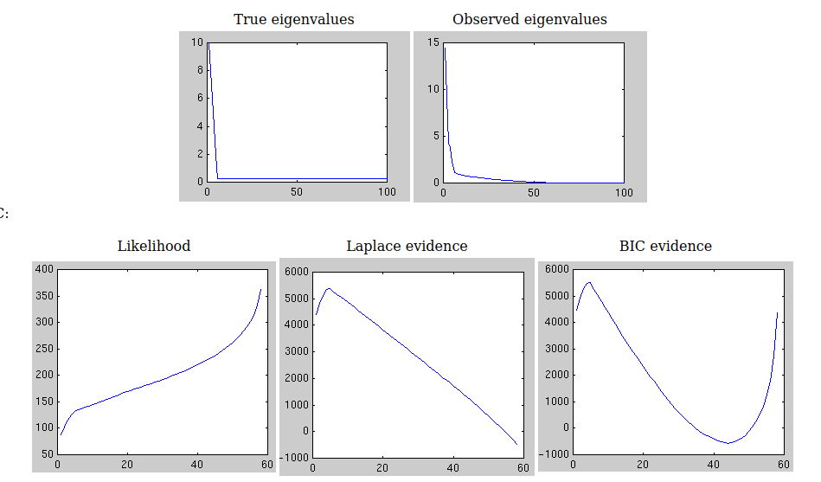
Bayesian Model Selection
Model Evidence:
Regression Changepoint Analysis PCA Dimension Selection
Or whatever you want...
http://alumni.media.mit.edu/~tpminka/statlearn/demo/

Slide 4
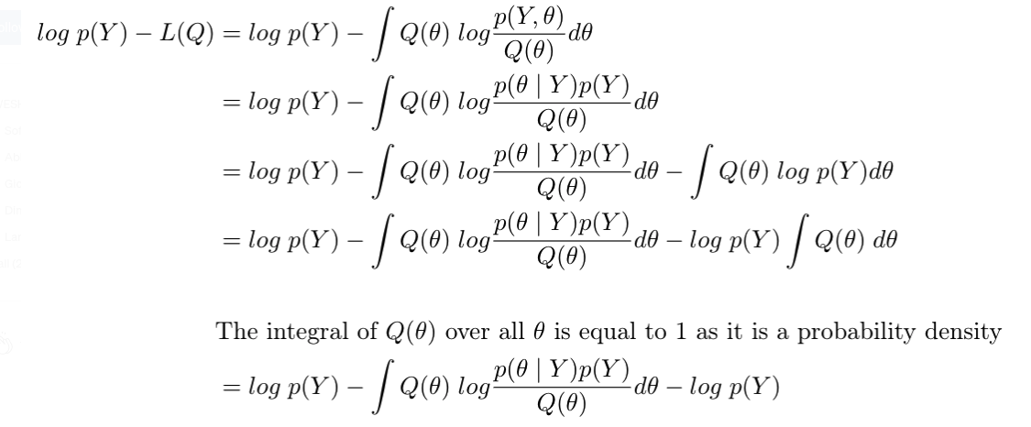
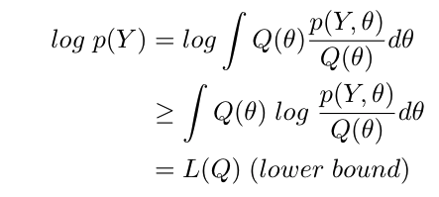
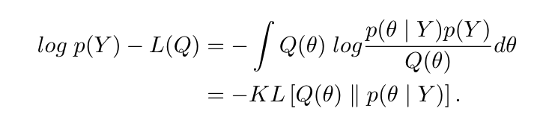
Variational Bayes
Estimate log marginal likelihood
Q is a variational parameter, AKA a model
Maximizing L(Q) by variation of Q sends Q towards posterior p(Θ|y)
https://towardsdatascience.com/variational-bayes-4abdd9eb5c12

Slide 5
Justification for Variational Bayes:
Akaike Information Criteria
Bayesian Information Criteria
ABIC
Do not account for interdependencies between parameters and form of prior
“Free Energy” => Variational Bayes
“The posterior moments (mean and covariance) are updated iteratively using Variational Bayes under a fixed-form Laplace, (‘‘i.e.’’, Gaussian), approximation q(θ) to the conditional density.
This can be regarded as an Expectation-Maximization algorithm; EM (Dempster et al., 1977) that employs a local linear approximation of the predicted responses around the current conditional expectation.”

Slide 6
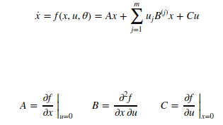
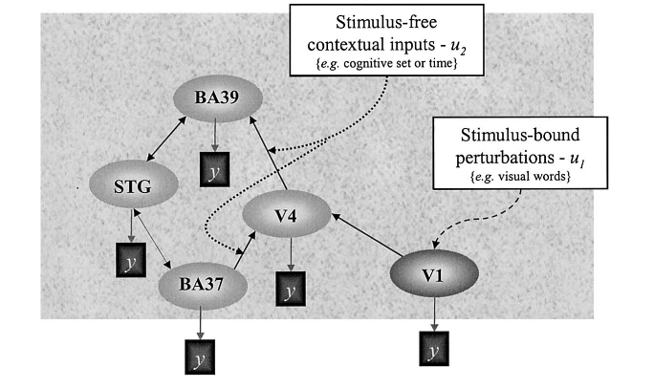
Fristonfication of Variational Bayes
Add Dynamics, Network Structure, estimate BOLD State: x, Input,: u
Neurals State -> Hemodynamic State -> Balloon Model -> BOLD
Parameters Theta:
http://www.scholarpedia.org/article/Dynamic_causal_modeling

Slide 7
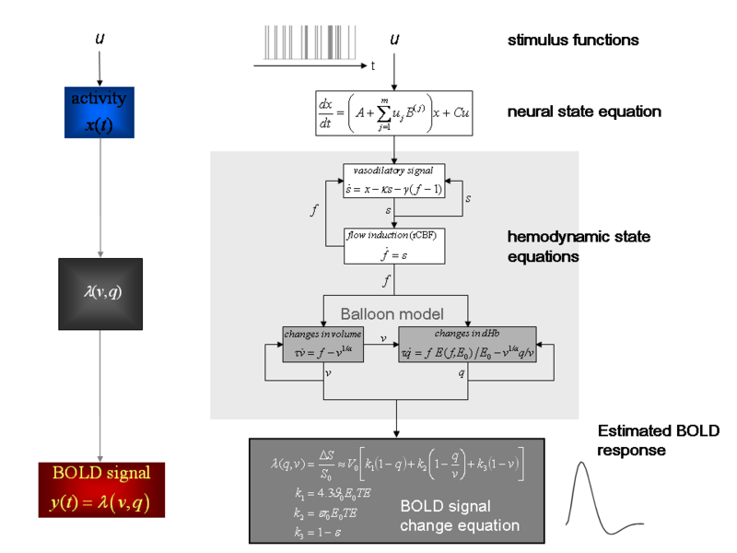
Forward Model: Full Schema (theta -> lambda)

Slide 8
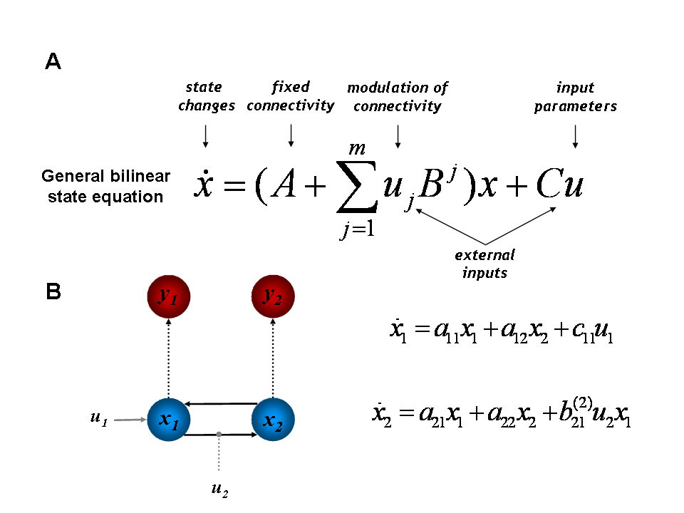
Bilinear Approximation
Figure 1: (A) The bilinear state equation of DCM for fMRI. (B) An example of a DCM describing the dynamics in a simple hierarchical system of visual areas. This system consists of two areas, each represented by a single state variable
Black arrows represent connections, grey arrows represent exogenous inputs and thin dotted arrows indicate the transformation from neural states (blue colour) into hemodynamic observations (red colour); see Figure 1 for the hemodynamic forward model. The state equation for this particular model is shown on the right. Adapted from (Stephan et al., 2007a).

Slide 9
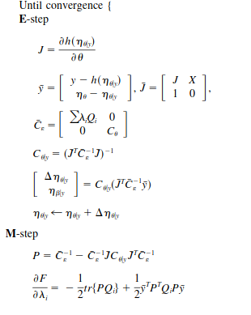
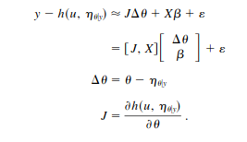
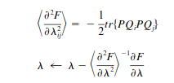
EM Equations

Slide 10
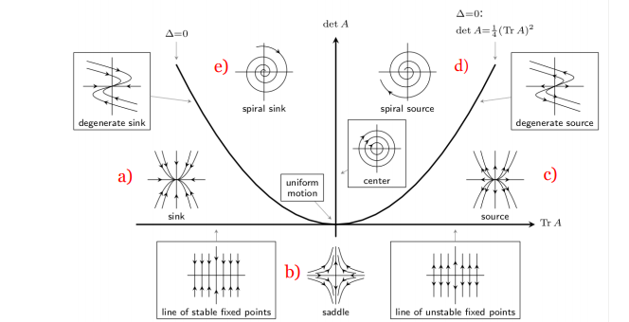
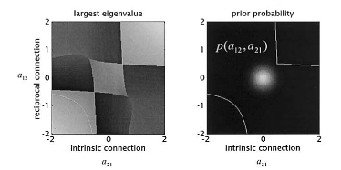
Priors
Principle lyapunov exponent <0 (no explosions please)
Also hemodynamic priors
Connectivity priors

Slide 11


How to get causality
Simplified DCM SEM (path analysis)
“in contrast to Granger causality (Granger, 1969), causality in DCM does not describe interactions among the observations themselves. Instead, DCM aims to infer interactions among hidden neuronal states that cause noisy observations through a (possibly nonlinear and spatially variable) mapping.” -- https://www.ncbi.nlm.nih.gov/pmc/articles/PMC2825373/

Slide 12
Practical Considerations for Hypothesis Testing
Requires good priors
Limited by explicit form for dynamics
Still unclear exactly what scientific workflow looks like

